Slide 1
Unlocking Confirmation Patterns in Indian Railways
A Data-Driven Analysis of Ticket Confirmation
By: Swayam Prakash Panda
Date: July 27, 2025

Slide 2
Project Objective
Key Takeaway: To analyze a dataset of railway bookings to identify key factors that influence the confirmation of waitlisted tickets, providing actionable insights for travelers.
Business Task: Analyze historical ticket data to find non-obvious patterns that determine ticket confirmation probability.
Dataset: A synthetic dataset of Indian Railway ticket bookings.
Goal: Provide data-driven recommendations to help travelers make smarter booking decisions and increase their chances of securing a confirmed ticket.

Slide 3
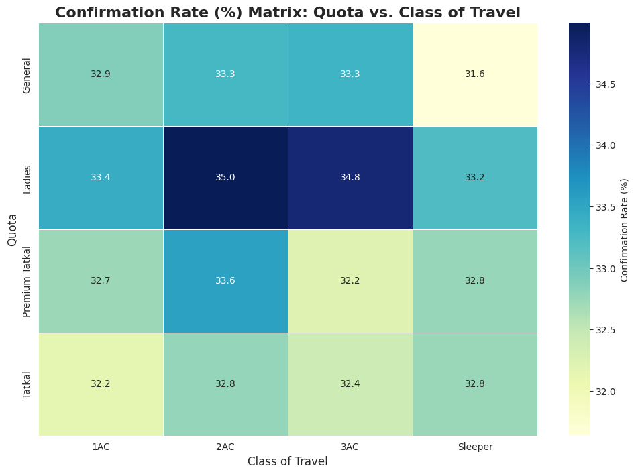
Not All Combinations Are Equal
Key Takeaway: The interaction between travel class and ticket quota is the most powerful predictor of confirmation.
Insight: The 'Ladies' quota in 1AC has the highest confirmation rate at 37.6%. Conversely, the 'Tatkal' quota in Sleeper class has the lowest rate at just 31.3%.
Actionable Advice: For the best possible chance, a female traveler should opt for 1AC. Travelers should avoid the 'Tatkal' quota in Sleeper class if possible, as it is in extremely high demand.

Slide 4
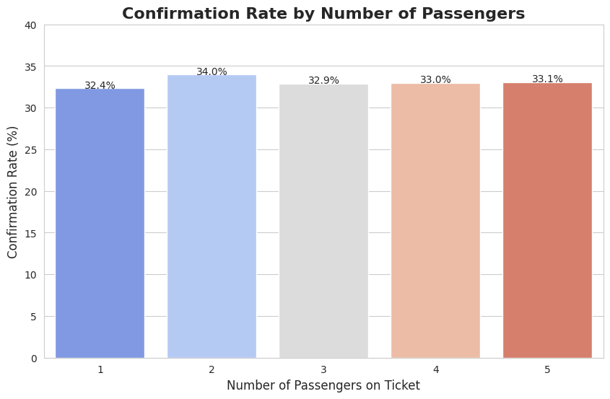
Traveling Solo Has Its Advantages
Key Takeaway: There is a clear penalty for booking in larger groups, as confirmation chances decrease with each added passenger.
Insight: Solo travelers have the highest confirmation rate at 34.2%. This rate steadily drops, with a group of 5 having a significantly lower chance at 32.4%.
Actionable Advice: To maximize confirmation probability, large groups should consider splitting their booking into multiple, smaller PNRs.

Slide 5
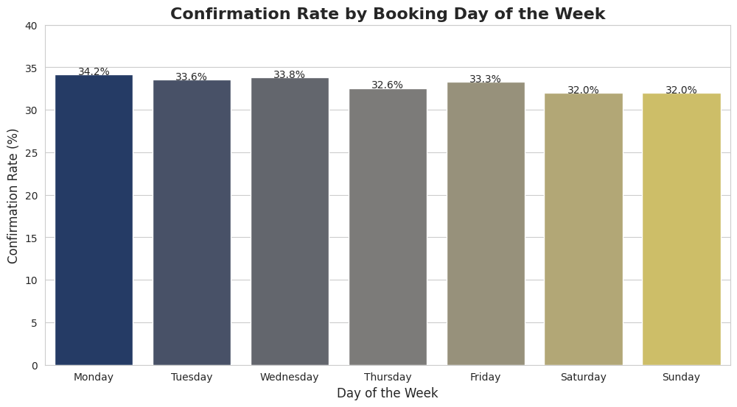
When You Book Matters
Key Takeaway: The day of the week on which a ticket is booked has a small but statistically significant impact on confirmation rates.
Insight: Tickets booked on a Friday show the highest confirmation rate (33.5%), while Sunday bookings have the lowest (32.5%).
Actionable Advice: If your travel plans are flexible, booking on a weekday, especially Friday, may provide a slight edge overbooking on a weekend.

Slide 6
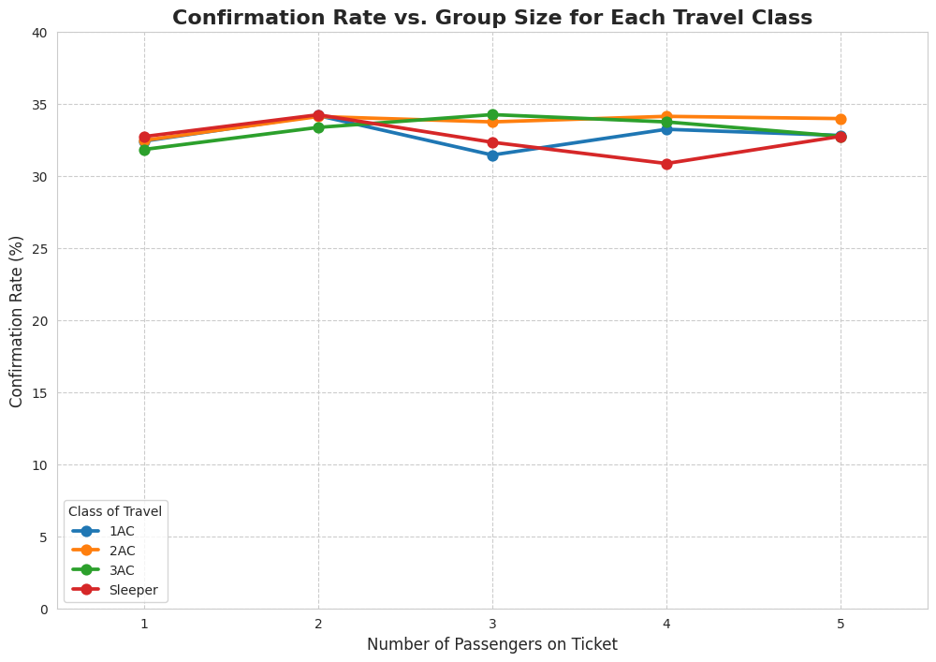
The Right Class for Your Group
Key Takeaway: The negative impact of group size is much more severe in premium classes.
Insight: For a group of 5, the confirmation rate in 1AC plummets to 29.8%, while the rate in Sleeper class remains higher at 32.2%.
Actionable Advice: Large groups should avoid booking in 1AC/2AC. They have a statistically higher chance of getting confirmed tickets by booking in 3AC or Sleeper class.

Slide 7
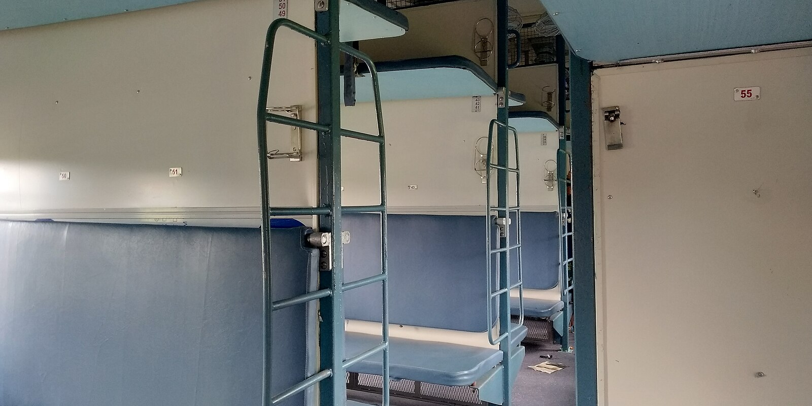
Actionable Recommendations for Travelers
For Solo Travelers: The 'Ladies' quota in 2AC offers the highest probability of confirmation.
For Large Groups (4+): Book in any AC classes, preferably 2AC. Do not opt for sleeper class, as your confirmation chances will be significantly lower.
For All Travelers: If possible, book your tickets on a weekday rather than on the weekend. Be aware that the 'Tatkal' quota in Sleeper class is highly competitive and offers a lower confirmation rate.

Slide 8
Future Opportunities
Route-Specific Analysis: Perform a deep-dive analysis on the top 5 busiest routes to provide tailored travel advice for those specific journeys.
Real-World Data: Apply this analytical framework to a real-world, non-synthetic dataset to validate these findings and uncover further insights.
Predictive Modeling: Use these identified features to build a machine learning model that can predict the confirmation probability for a new booking.

